Slide 1

5 best Practices in Devops culture

Slide 2
Agenda
At the end of this session you will be able to understand
What is DevOps
Why DevOps culture is required
How different organizations have implemented DevOps
Different DevOps tools
5 best practices of DevOps culture

Slide 3
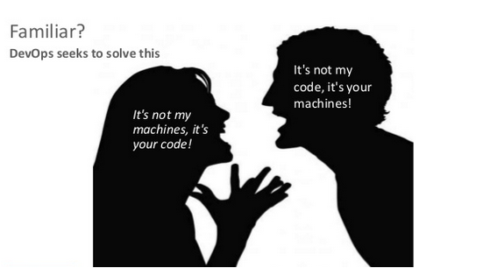
DevOps from 50,000 Feet

Slide 4



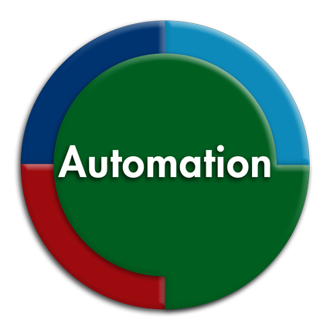
DevOps at work
DevOps is a combination of the followings :

Slide 5
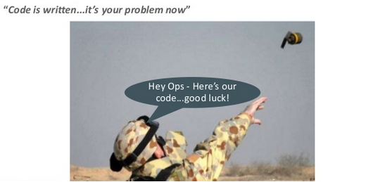
Common Problem
Code is thrown at deployment/operations team as a bomb

Slide 6
Why DevOps ?
Today’s Business Environment
Increasingly fast moving, competitive, technology driven world

Slide 7
Why DevOps ?
Today’s Business Environment
Increasingly fast moving, competitive, technology drive world
Speed, agility and faster time to market becoming increasingly important

Slide 8
Why DevOps ?
Today’s Business Environment
Increasingly fast moving, competitive, technology drive world
Speed, agility and faster time to market becoming increasingly important
Applications and Softwares are the new battleground

Slide 9
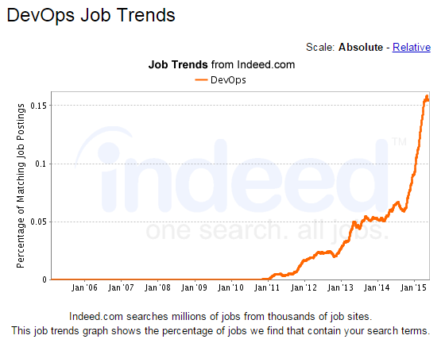
DevOps Job Trends

Slide 10

DevOps at Amazon
“ At Amazon a new deployment is done after every 11.6 seconds
Maximum number of deployments done by Amazon is 1000 in an hour “
Jon Jenkins
Amazon.com
Director of Platform Analysis

Slide 11

DevOps at Facebook
Facebook's entire code base is compiled down to a single binary executable, which represents the entire Facebook application and is approximately 1.5GB in size
At facebook we follow Ship early and Ship often culture. Our philosophy mirrors the "DevOps" movement, which encourages lowering the wall between software development and IT operations
Chuck Rossi
Facebook Release Engineer

Slide 12

DevOps at Etsy
Etsy has about 60 million monthly visits and 1.5 billion page views per month. Etsy, renowned for its DevOps and Continuous Delivery practices, does almost 50 deploys/day.
At Etsy developer’s needs to know the answer to the question "how comfortable am I with deploying a change right now?".
Daniel Schauenberg
Infrastructure Toolsmith, Etsy

Slide 13
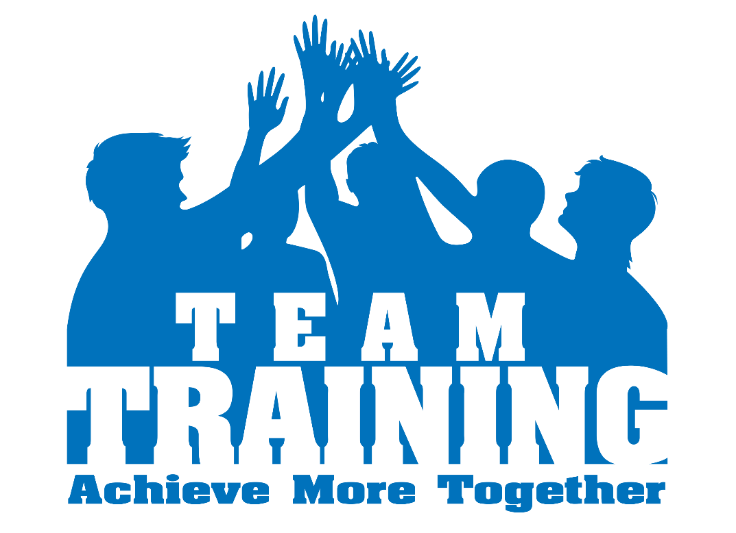
DevOps Practices - Training
Train everyone on new devops tools and new workflows
It takes time to learn new tools, no matter how excited the team is about it
Appreciate learning together
Assign each team member some responsibility

Slide 14
DevOps Skills
DevOps Tools – Ability to administer and customize them
Scripting Skills – Demonstrates the traditional scripting skills to IT operations
Coding Skill – Should possess developer skills in using automation
Process re-engineering Skills – Reflects the holistic view of IT and development as a single system, instead of two different functions
DevOps Skill Matrix
Skills | Products
Linux/Unix | Commands & Administration
Shell Scripting | Bash, Sed/Awk
Coding | Perl, Python, Ruby
Configuration Management | Puppet, SaltStack, Chef
Bare Metal Configuration | Cobbler, Foreman, PXE, DHCP, DNS

Slide 15
DevOps Tools
Tools for DevOps can be categorized based on the layer of Automation you choose
Each layer has its own tools to build Automation
Infrastructure Automation | Cobbler Foreman Crowbar
Configuration Management | Puppet SaltStack Chef
Continuous Integration | Jenkins, Hudson SVN, Git, Perforce Ant, Maven
Continuous Deployment | Capsitrano Custom Tools Yum, Deb, RPM
Monitoring | Nagios, Sensu, Zabbix Custom Tools

Slide 16
DevOps Tools (Contd.)
Revision control System | Git Cvs Subversion
Software Configuration Management | Clearcase perforce Accurev
virtualization management Software | Vcentre Hyper-V

Slide 17





DevOps Tools
Code Tool
System Monitoring Tool
Open Source Proxy Server
Version Control System
Automated Build Tool

Slide 18

DevOps Practices – Share and Speak Out
Talk about your project internally and externally
Have a multitude of skills
You won’t do it perfectly the first time, but it should not stop you from doing it
Most probably someone have already faced and solved the problem what you are facing, seek guidance

Slide 19

DevOps Practices – Change the process
Collaborate between development and operations
Improve and automate whatever possible
Create feedback loops at every stage

Slide 20
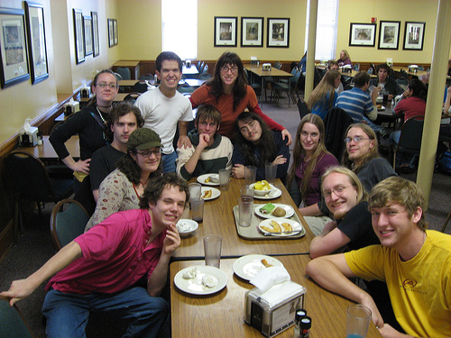
DevOps Practices – People Matters
Break down barriers between teams
Build trust – In each other, In technology, In process
Ensure focus on business service not technology

Slide 21

DevOps Practices – Build a diverse team
Build a project team having all different skills
Development
Continuous Integration
Deployment
Testing
Infrastructure measurement

Slide 22
References
http://arstechnica.com/business/2012/04/exclusive-a-behind-the-scenes-look-at-facebook-release-engineering/1/
https://www.facebook.com/video/video.php?v=778890205865
https://blog.newrelic.com/2014/06/02/devopsculture/
http://gotocon.com/dl/goto-amsterdam-2014/slides/DanielSchauenberg_DevelopmentDeploymentCollaborationAtEtsy.pdf

